Slide 1
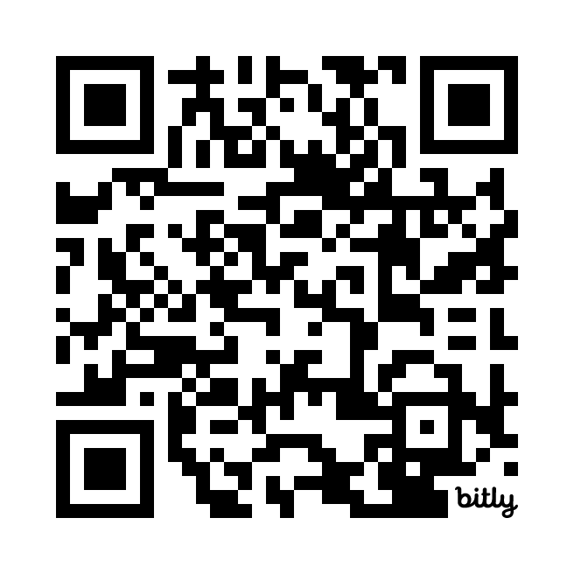
Use Cases Quiz
https://bit.ly/4apwM5i

